Slide 1
Indoor Routing in Three Dimensional Spaces (Case Study: Telkom University, Bandung)
Tiara Annisa Dionti (1103134405)

Slide 2
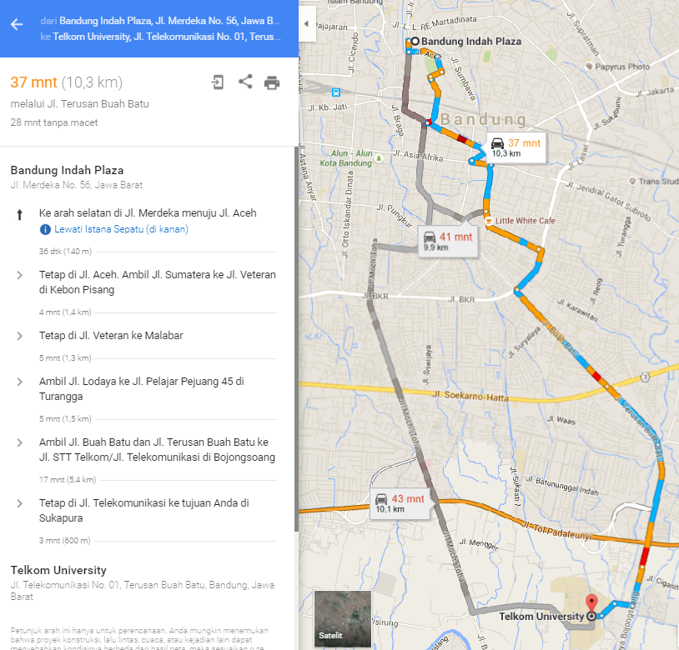
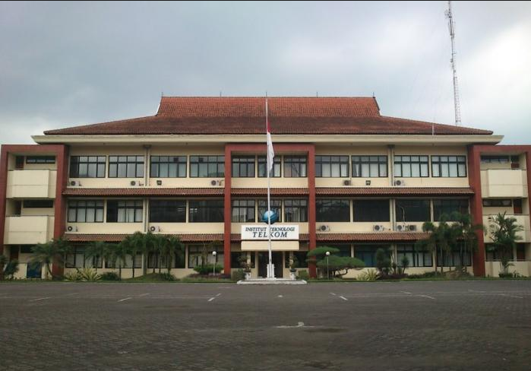
Introduction
?
Two dimensional spaces outdoor routing
How about indoor routing in multi-floor building?

Slide 3

Objective
Knowing how the representation of three-dimensional spaces can be implemented to build a data structure of the existing space in the Faculty of Informatics Engineering of Telkom University.
Knowing how an indoor routing system can be implemented in three dimentional spaces.
Knowing how the performance of the system using three dimentional routing indoor spaces.

Slide 4
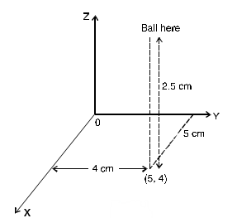
Three Dimensional Spaces

Slide 5
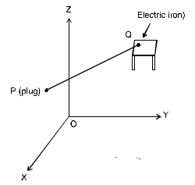
Simple Example to Find the distance between two points
$$\left|PQ\right|= \sqrt{{\left(x_{2}−x_{1}\right)}^{2}+{\left(y_{2}−y_{1}\right)}^{2}+ {\left(z_{2}−z_{1}\right)}^{2}}$$

Slide 6
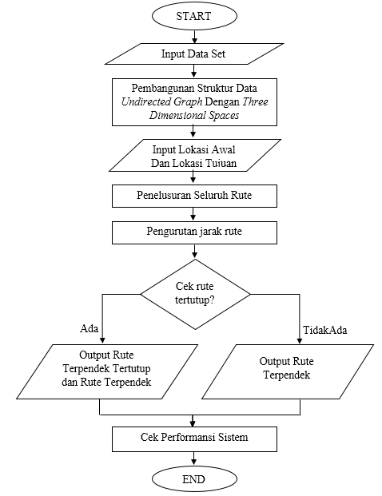


System’s Flow Chart

Slide 7
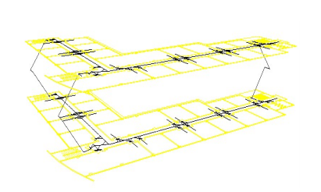
three dimensional spaces Structure

Slide 8
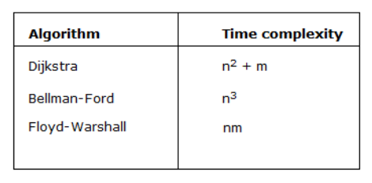
Shortest path algorithm
Source :
Magzhan, K., & Jani, H. M. (2013). A review and evaluations of shortest path algorithms. International journal of scientific & technology research, 2(6).

Slide 9
Thankyou ☺

